Slide 1

Institute for Stochastics and Applications Mathematical modeling and simulation of cellular systems
Leveraging Genetic Algorithms to Predict Initial Conditions for Optimal Spatial Patterns in 2D Reaction-Diffusion Systems
Loghman Samani
09.07.2024

Slide 2
Synthetic morphogen systems
Synthetic Notch system
S. Toda et al., 2020
Arbitrary proteins engineered into synthetic morphogens.
Formation of gradients and directing cell patterning.
Applications in advanced tissue engineering.
“Engineering synthetic morphogen systems that can program multicellular patterning”
Diffusible synNotch system. (S. Toda et al., 2020)

Slide 3
Computational model
Proteins Present in the System
Morphogen
Inhibitor
Anchor
Mathematical Equations (S. Toda et al., 2020)
Diffusion: Represents the spread of proteins
Inhibitor binding: Interaction between morphogen and inhibitor
Anchor binding: Interaction between morphogen and anchor
Degradation: Rate at which proteins degrade over time

Slide 4
Protein Secretion Patterns
Morphogen Secretion
Inhibitor Secretion
Cells capable of producing morphogen
Indicated by green cells
Cells capable of producing inhibitor
Indicated by red cells

Slide 5
Diffusion Patterns
Analysis of protein diffusion in a 2D tissue compartment.
Examining three distinct diffusion patterns based on cell location.
Corner Cells
Edge Cells
Central Cells
Cells located at the four corners of the compartment.
Cells situated along the edges of the compartment.
Cells positioned in the middle, away from edges and corners.

Slide 6
Simulation Results
Using ODEs to Simulate the System
Compartment Size: 100 x 100
GFP Production: First 10 columns on the left
GFP Inhibitor Production: First 10 columns on the right
Anchor Production: None
Free GFP Inhibitor-GFP Free Inhibitor

Slide 7
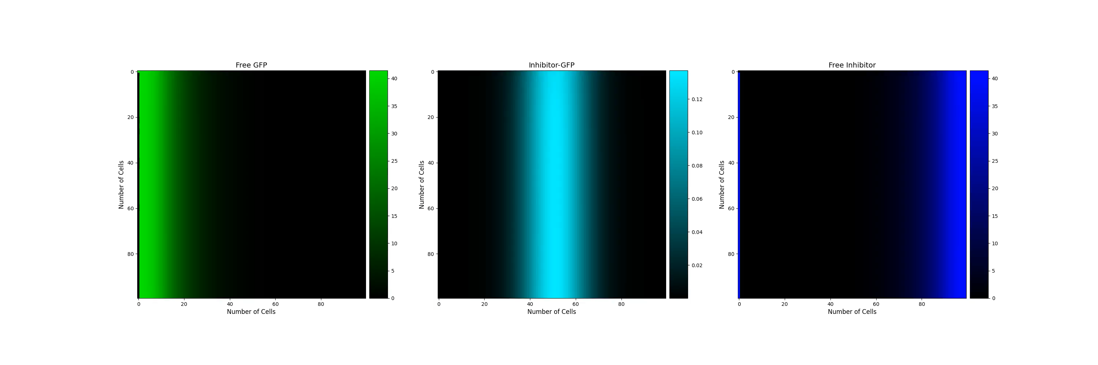
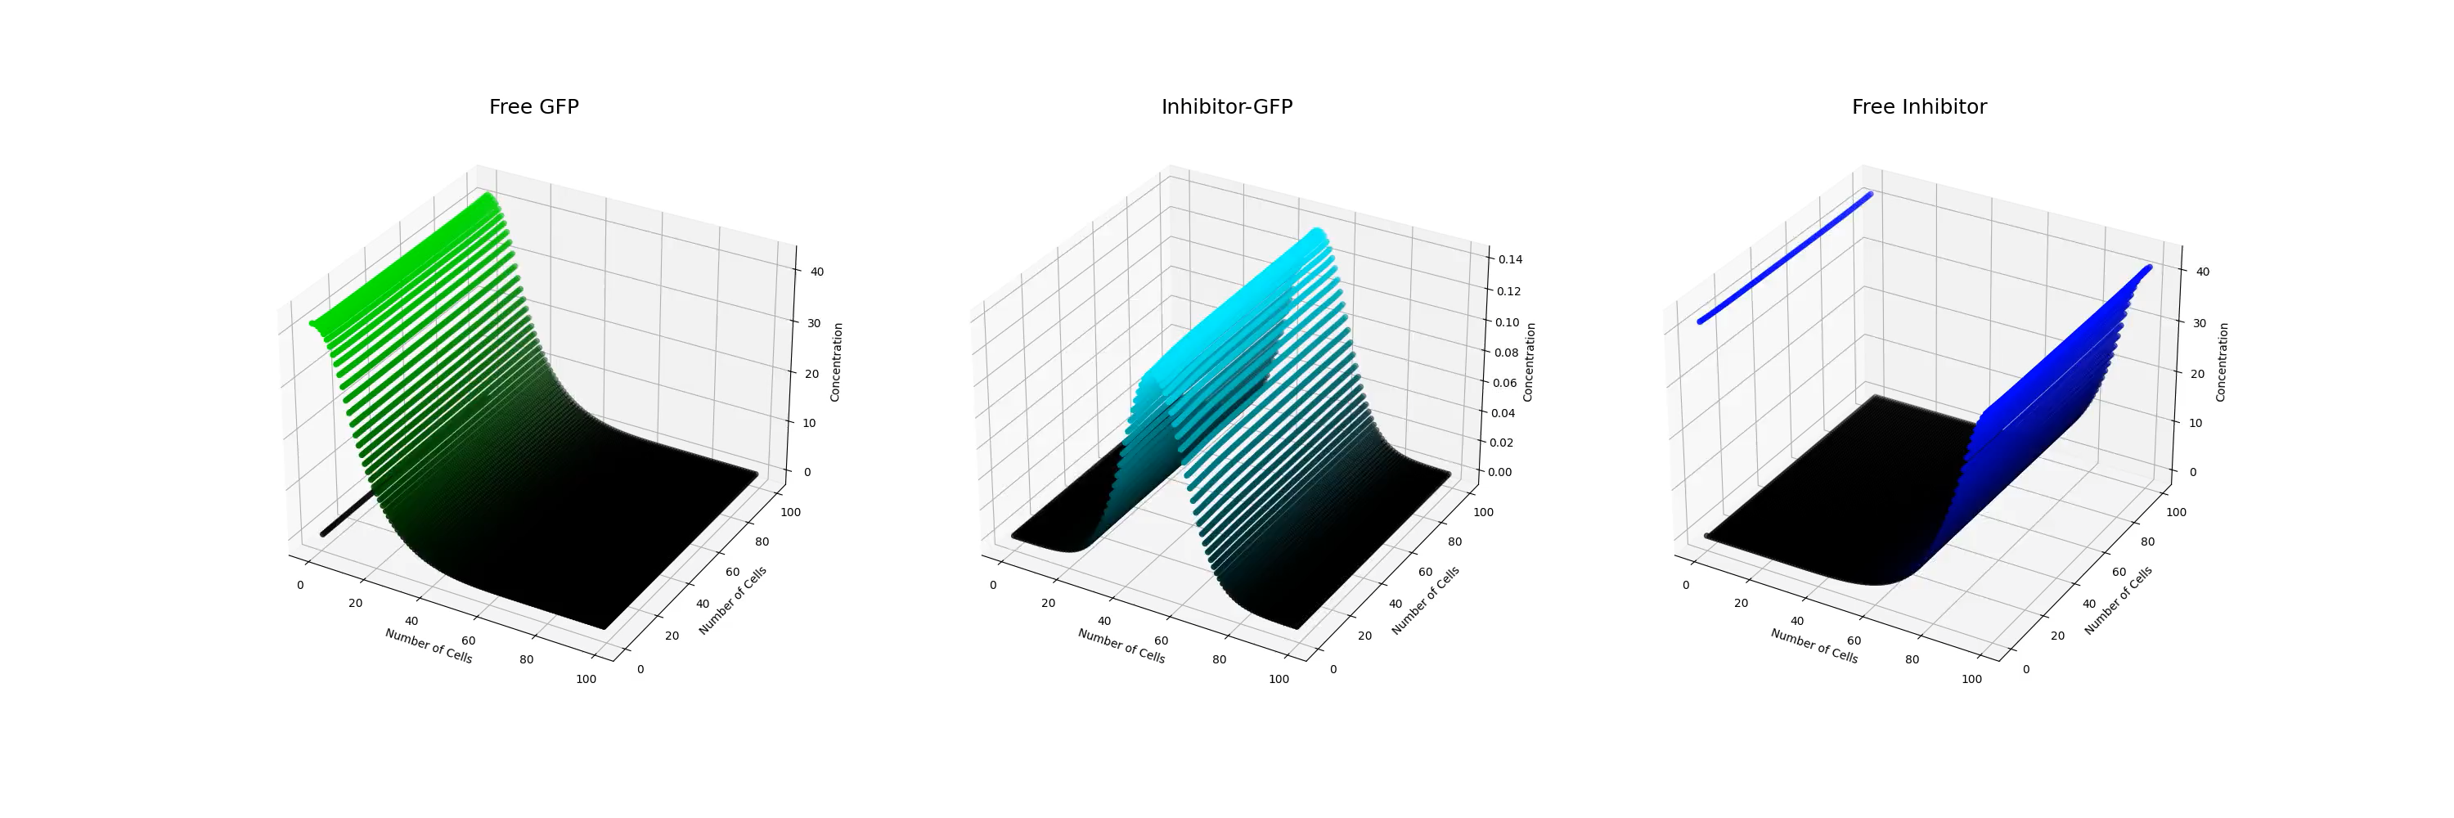
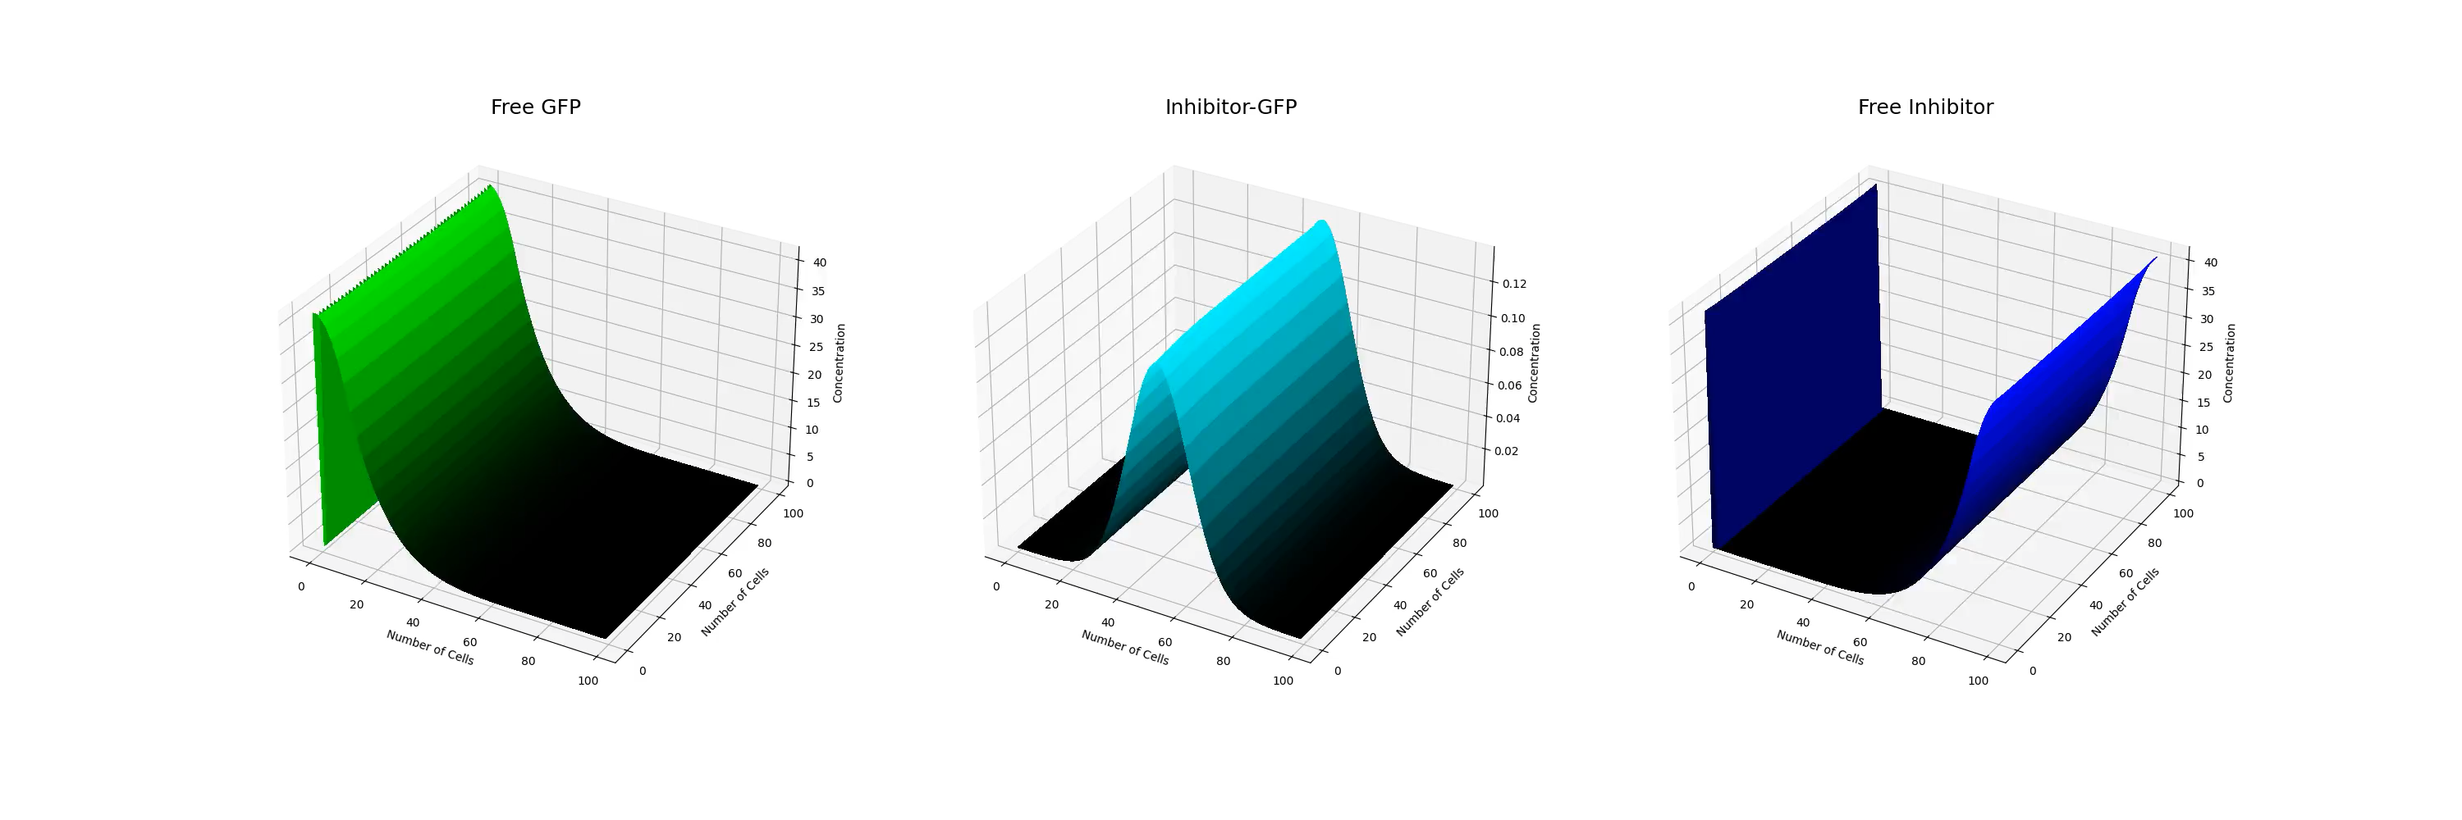
Number of iterations = 2500
Number of frames = 500
Initial morphogen and inhibitor concentration in each cell = 5

Slide 8
Genetic Algorithms for Pattern Formation
R. Mousavi and D. Lobo, 2024
Using genetic algorithms to optimize initial protein concentrations for desired spatial patterns.
Develop a genetic algorithm to design and optimize protein concentrations for spatial pattern formation in our system.
“Automatic design of gene regulatory mechanisms for spatial pattern formation”

Slide 9
Genetic Algorithms (GAs)
Introduction
Population Initialization
mimic the natural selection process to find optimal solutions
Pioneered by John Holland’s work(1970s)
represent potential solutions as chromosomes
evolve populations towards better solutions by applying genetic operators like recombination and mutation
Simulation
Fitness Computation
Selection of Survivors
A. Lambora et al., 2019
Recombination (Crossover)
Mutation
Update Population
Return the Best Result/s

Slide 10
Genetic Algorithms
Population Initialization
Each species matrix is created as a random binary string.
Each chromosome is a list of binary strings.
Each string represents an initial species or parameter matrix.
The population is a nested list, with each value being a chromosome.
Parameters sp 1 sp 2 sp 3 sp 4 sp 5 sp 6

Slide 11
Genetic Algorithms
Simulation
Convert binary chromosomes into real number matrices.
Each converted chromosome is a list of species and parameter matrices.
Simulate the system using each chromosome.
Convert simulation results back to binary.
Store results in a list

Slide 12
Genetic Algorithms
Fitness Computation
Evaluate how close each individual is to the target solution
Compare each simulation result binary string to the target binary string
Result is a list of fitness values for the population

Slide 13
Genetic Algorithms
Selection of Survivors
Fitness Proportionate Selection (Roulette Wheel Selection)
Randomly select individuals based on their probabilities
Select parents for the next generation based on fitness scores
Result is a list of selected parents for the next generation

Slide 14
Genetic Algorithms
Recombination (Crossover)
Genetic recombination of parents to generate offspring
Offspring O1​ and O2​ inherit traits from both parents
crossover_rate: Probability of crossover.
i: Index of sub-chromosome in chromosomes

Slide 15
Genetic Algorithms
Mutation
Introduce random changes to the chromosome
Enhance genetic diversity for better exploration
prevent local minima
mutation_rates: Probability of mutating each bit

Slide 16
Genetic Algorithms
Update or Break!
Stop: If desired or optimal fitness achieved
Update: Otherwise, update population and repeat
Iterative Process: Continues until convergence

Slide 17
Results of the genetic algorithm

Slide 18
Project Challenges and Solutions
Computational Intensity
Model Specificity
Non-Uniform Gradient in Diffusion
GA Inefficiency
Solution: Parallel computation, Numba (@jit), Julia
Solution: Generalize with modular blocks
Solution: Optimize diffusion calculation method
Solutions:
Improve fitness function
Alternative chromosome representation
Better selection methods
Notes:
challenge: Computational intensity in both simulation and GAs optimization Solution: parallel compotation (vectorization the code), using libraries like numba to run the code just in time (@jit) or programming languages like julia which are more appropriate for numerical computation than python (which we corrently use) challenge: specificity of the models (for each model at the moment we should write a specific code) Solution: generalize the models (e.g. using building blocks for each concept and choose some of them based on your needs) Challenge: The specie diffusion in our simulated models does not have a unify gradient in a row (which should be the case in our case becase we use ode and same initial concentration for the same specie in each cell) Solution: the problem is maybe because we use loop for calculating diffusion and it means cell after cell it will be calculated which may cause ununify gradient. Challenge: Efficency of GAs (our corrent model does not converge 100 percently) reasons: 1) fitness function may not be the best one(it tries to maximize the fitness using bit with bit comparision), 2) binary representation of the chromosomes may not be the best percidure(ist efficient but may not be the best choise) becase each number in a matrix is represented with 8 or more bits, so the chromosome length is 8 times bigger, 3) selection functions which we use may not be the best choices (Roulette-Wheel & tournament) Solution: we will search for new ways and functionalities and examine them to improve our models.
Lost of information during conversion from real number to binary and vise versa

Slide 19
Project Outlook
Improve Current Models
Simulate in Higher Dimensions
Add Growth Rate
Enhance Information Sharing
Increase Diffusion Edges
Incorporate Stochastic Methods
Advance GA Algorithm
Combine Optimization Algorithms
Create a Simulation Library
Notes:
Improve Current Models
Solve previously mentioned challenges
Simulate in Higher Dimensions
Expand from 2D to 3D simulations
Add Growth Rate
Introduce cell division to mimic biological systems
Enhance Information Sharing
Increase the number of neighboring cells sharing information
Increase Diffusion Edges
Allow diffusion in more directions beyond the current four edges
Incorporate Stochastic Methods
Use stochastic methods alongside ODEs for simulations
Create a Simulation Library
Develop a Python library for 1D, 2D, and 3D simulations
Advance GA Algorithm
Allow GA to add new species through mutation
Use various mutation types like insertion
Combine Optimization Algorithms
Integrate different optimization methods to enhance GA performance
Improving current models (it means solve the challenges which i mentioned in prevoius slide, project challenges and solutions) Simulating the system in higher dimensions (our current simulation models are implemented in 2D, which we will try 3D also) Adding growth rate to the system (it means till now each compartment wich we choose to simulate our models has a fixed number of cells, which we will add a growth rate to bring the system a step forward to more look like a biological system in which cells divide and the overall cell number is increased through time) In our models each cell can share infos with just the forst cell in each edge in it‘s neighrorhood (in some cases we add the option to share infos with cells) we may increase the number of cells which share infos with a cell), the frst cell is directly connected and the second one indirectly through the second one and so on. increase the diffusion edges (currently in our models each cell is connected and shares information with just four cells (each cell is a square so there is four edges and in each edge just one neighbour cell)), for example diffusion in infinite direction will be perfect Using also stochastic methods to simulate the system (currently we use ODEs to simulate the systems) Collect all implementation and create a library (python library) for simulating in 1, 2 and 3D Develope our GA algorithm, so that it will be able to add new species (to add non-linearity to it‘s predictions) ,throgh mutation process, to the models, currently our model is a model with the fix number of species and uses only point mutation(bit mutation) we can use other sort of mutations like insertion (insert a new specie) to our model. Combining/using different optimization algorithms to our GA model/to optimize our models to improve it‘s performance, currently we have not decided to use which algorithms, but we will consider this idea in our project.

Slide 20
Thank you for your time and attention

Slide 21
hm1.mp4
infos = { "compartment length": 100, "compartment width": 100, "initial cell number": 5, "start": 1, "stop": 50, "dt": 0.02, "save step interval": 5, "k_fm_sec": 0.5, "k_fi_sec": 0.5, "k_am_on": 0.04, "k_am_off": 2e-6, "k_im_on": 0.2, "k_im_off": 2e-4, "k_fm_deg": 0.02, "k_fi_deg": 0.02, "k_im_deg": 0.02, "k_am_deg": 0.02, "k_m_diff": 4, "k_i_diff": 4, "k_im_diff": 3 }
Number of iterations = 2500
Number of frames = 500
Initial cell number: initial concentration of morphogen or inhibitor in capable cells. (initial cell number/ ratio: initial concntration of anchor in capable cells(5))

